Slide 1
Spatiotemporal Reconstruction, Navigation, and Relational Memory in the Hippocampus
Introduction
Reconstructing Relational Information
Spatiotemporal Reconstruction
Spatiotemporal Navigation
Conclusion
Kevin Horecka, December 1st, 2017 Preliminary Examination

Slide 2
Outline
Introduction
Reconstructing Relational Information
Spatiotemporal Reconstruction
Spatiotemporal Navigation
Conclusion
General Introduction
Reconstructing Relational Information
Spatiotemporal Reconstruction
Spatiotemporal Navigation
General Conclusions

Slide 3

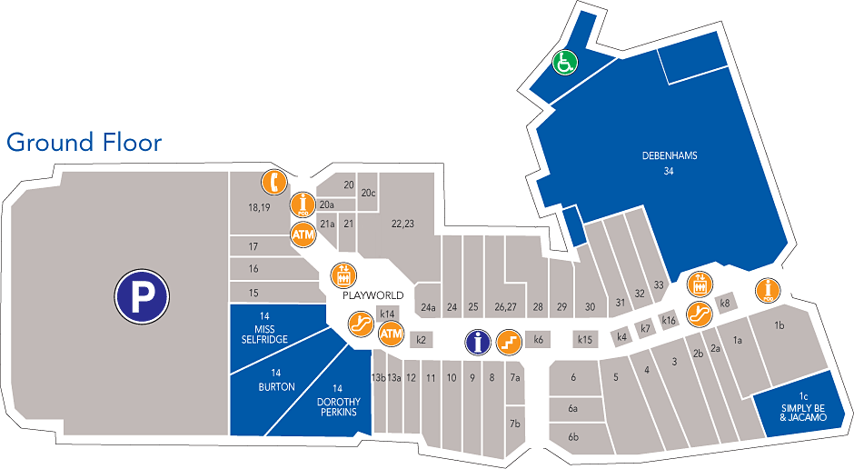
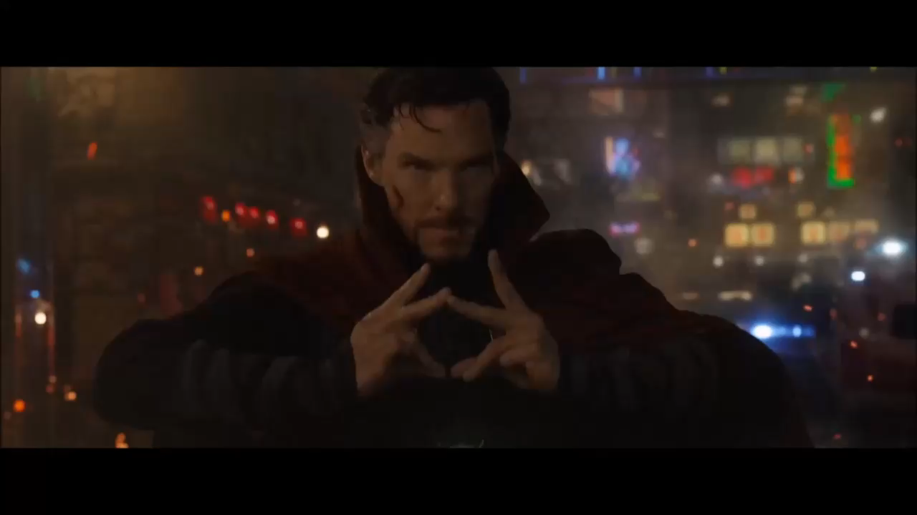
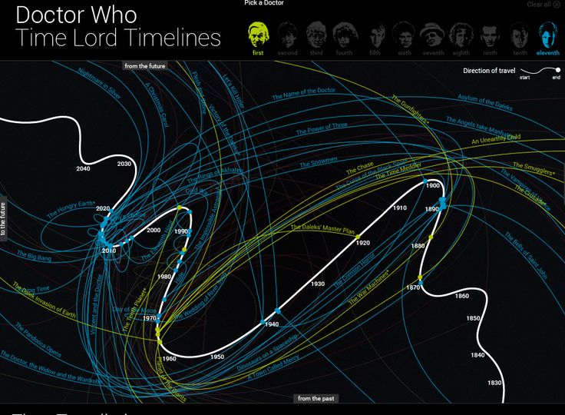

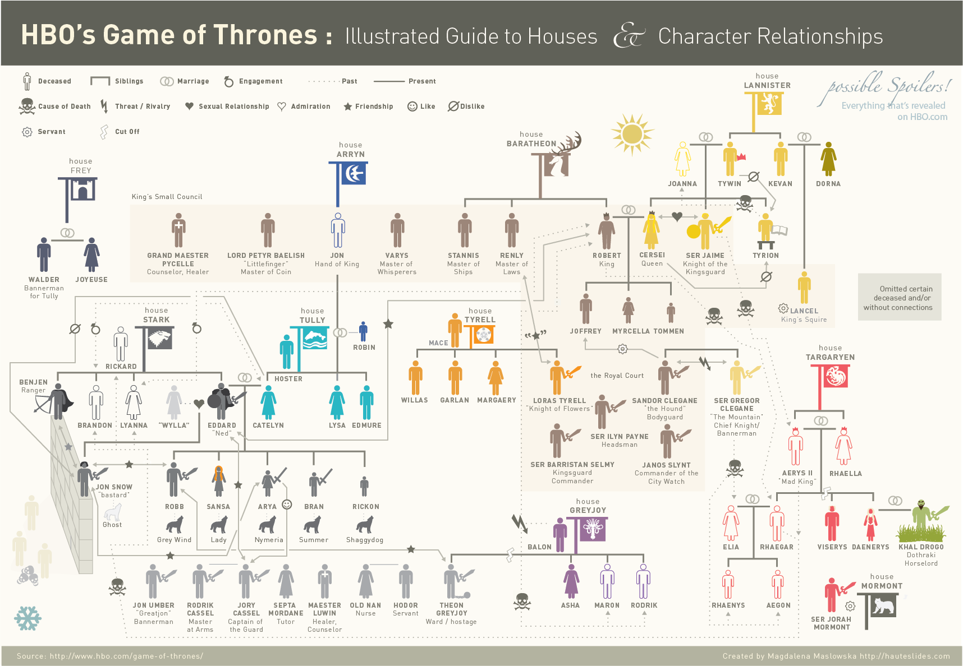
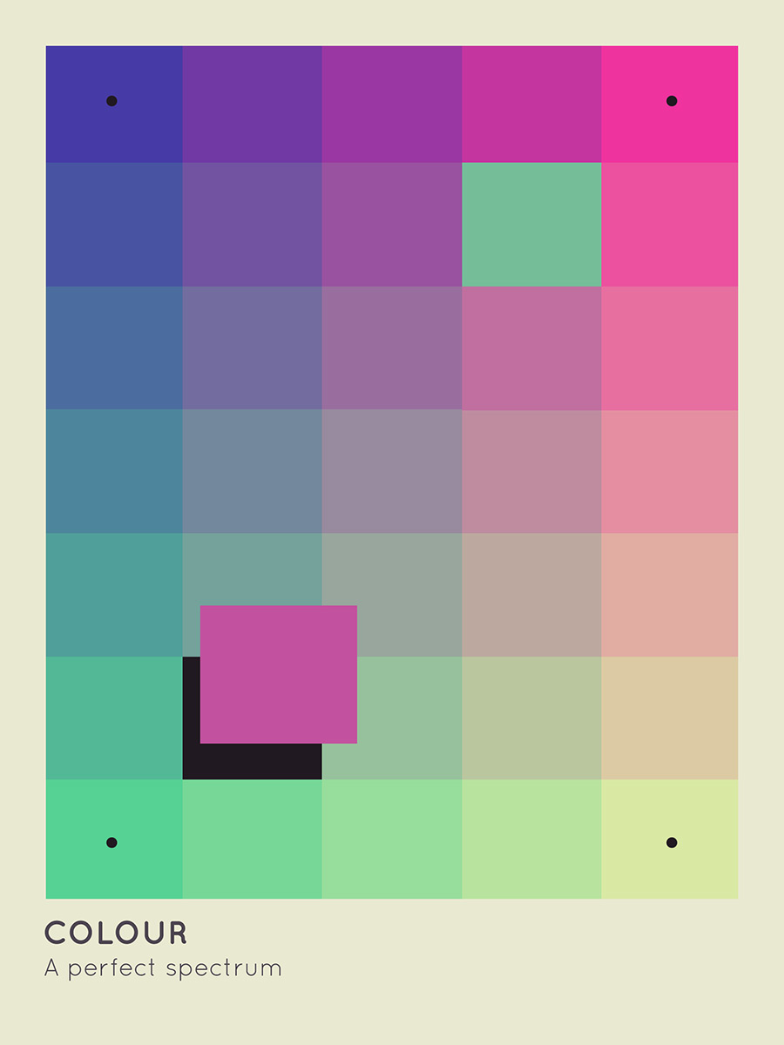
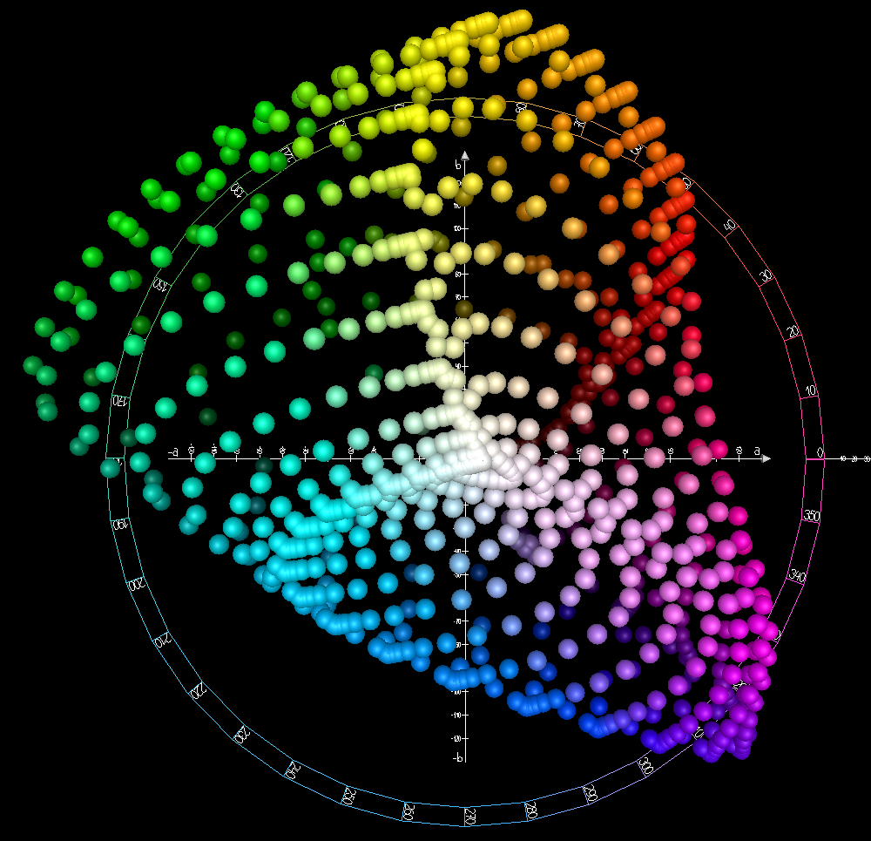
What is reconstruction?
Introduction
Reconstructing Relational Information
Spatiotemporal Reconstruction
Spatiotemporal Navigation
Conclusion
Begin with some data in a (usually continuous) domain
Space
Time
Color
Social Space

Slide 4
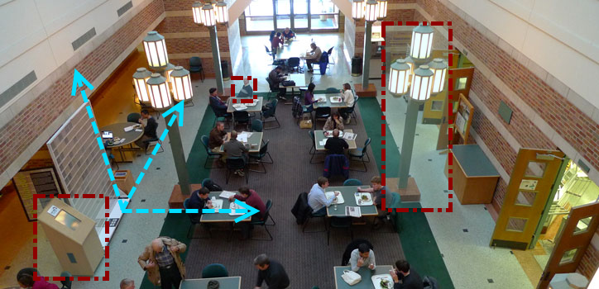
Real-World Reconstruction
Introduction
Reconstructing Relational Information
Spatiotemporal Reconstruction
Spatiotemporal Navigation
Conclusion

Slide 5
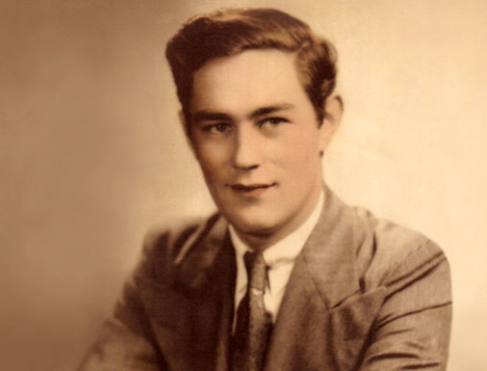
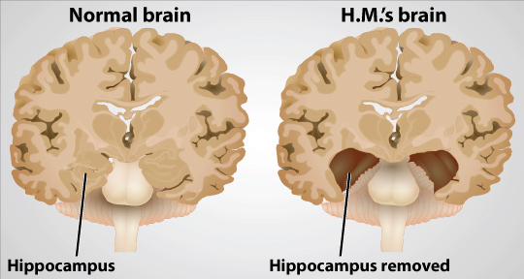
Episodic Memory
Introduction
Reconstructing Relational Information
Spatiotemporal Reconstruction
Spatiotemporal Navigation
Conclusion
Episodic memory can be defined as memory for specific/precise events in space and time, framed by context
Episodic memory is destroyed by bilateral removal of hippocampal structures (see Patient H.M., right)
In the introduction of Episodic Memory in Tulving, 2002, Episodic Memory is described as “a singular exception” to the “unidirectionality of time”

Slide 6
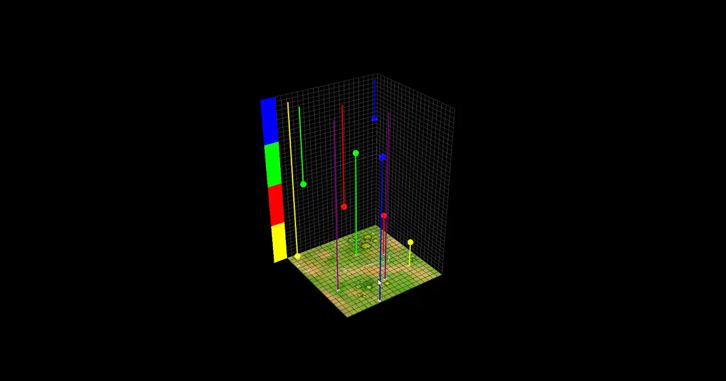
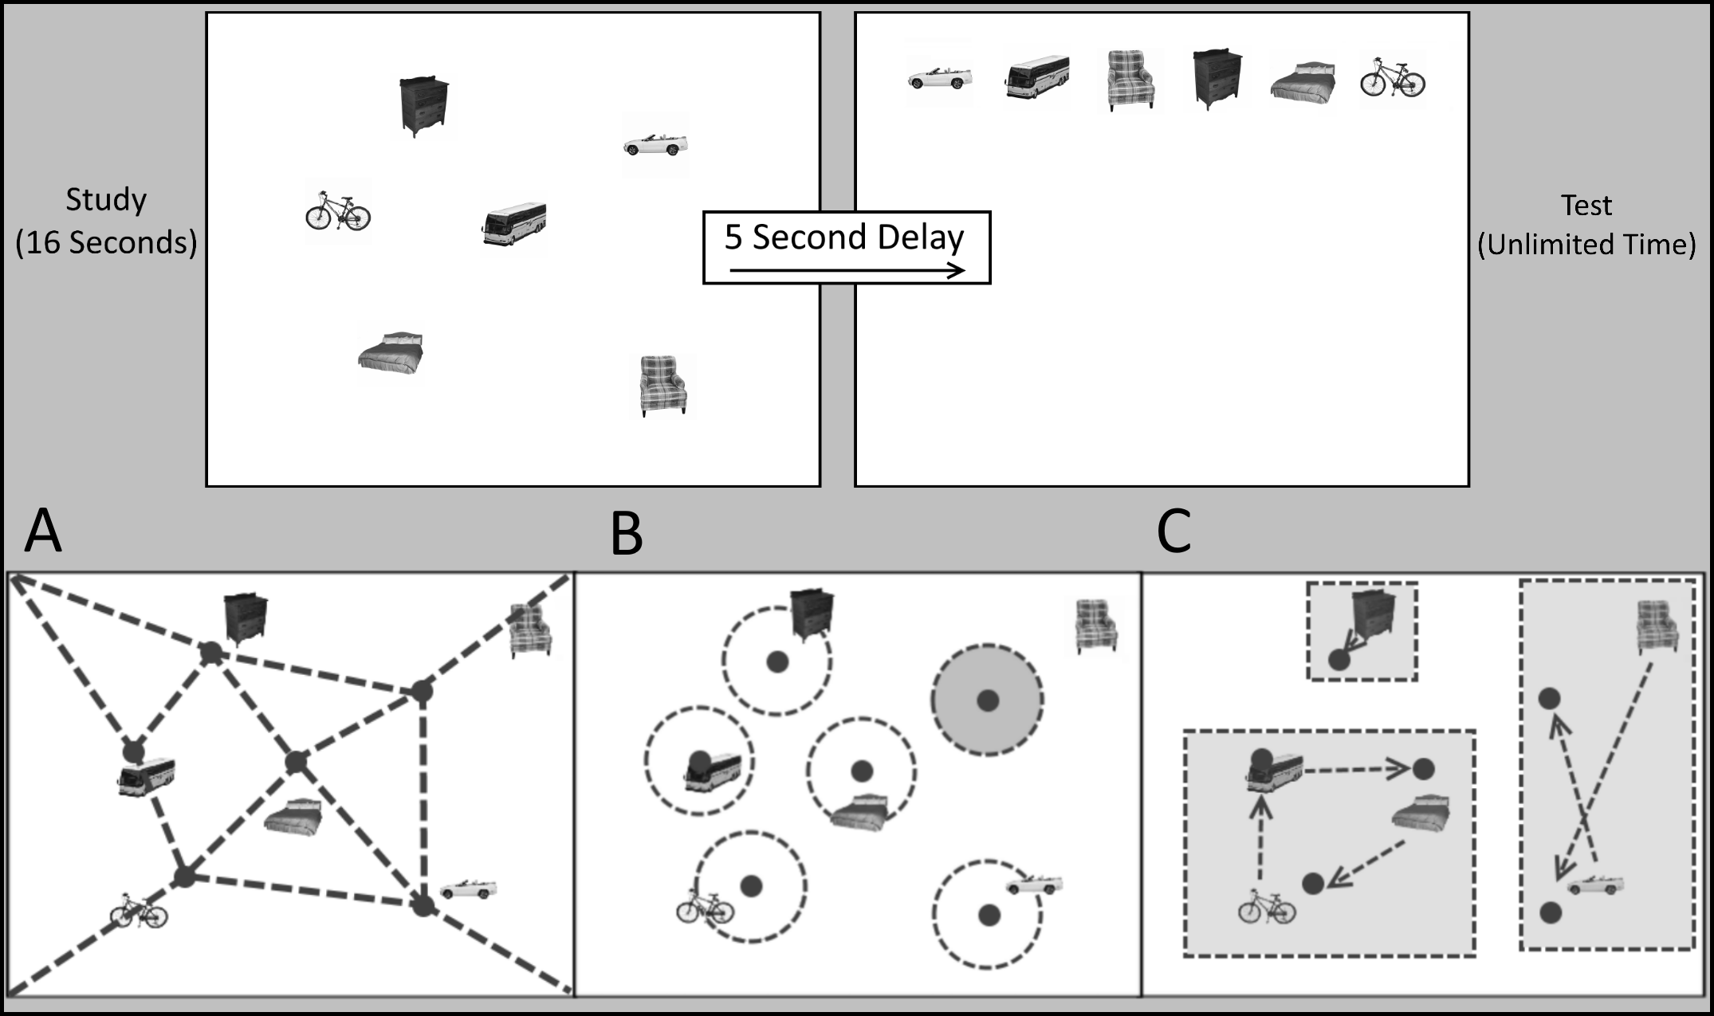
Reconstruction Tasks
Introduction
Reconstructing Relational Information
Spatiotemporal Reconstruction
Spatiotemporal Navigation
Conclusion
Reconstruction Tasks ask participants to:
Study some information in a domain
Place that information back in the domain the way they remember it being

Slide 7
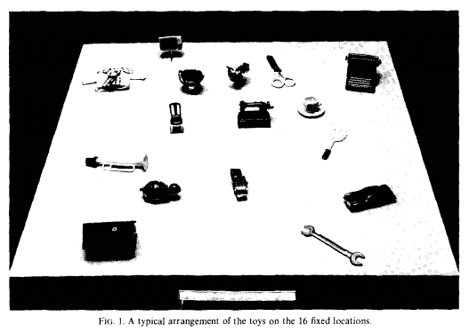
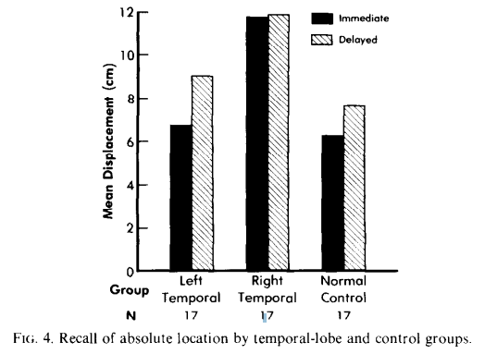
Smith and Milner 1981
Introduction
Reconstructing Relational Information
Spatiotemporal Reconstruction
Spatiotemporal Navigation
Conclusion
Reconstruction in hippocampal damaged patients
Right temporal lobe patients showed a deficit in location memory immediately
Both temporal lobe damage patient groups showed location memory impairment after delays

Slide 8
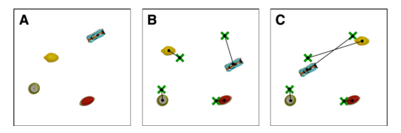
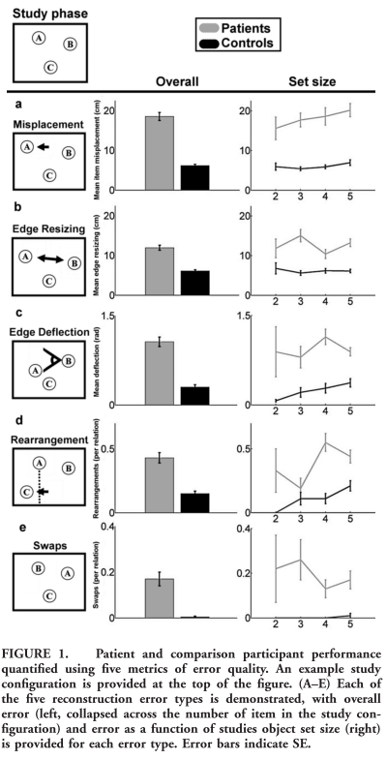

Jeneson et al. 2010 & Watson et al. 2013
Introduction
Reconstructing Relational Information
Spatiotemporal Reconstruction
Spatiotemporal Navigation
Conclusion
Similar to Smith & Milner with fewer items
Varied number of items (up to 7 and 5, respectively)
Analysis was very coarse (lacking specificity and sensitivity)
Both showed deficits in misplacement and relational errors (interchanging or “swapping” of pairs of items)

Slide 9
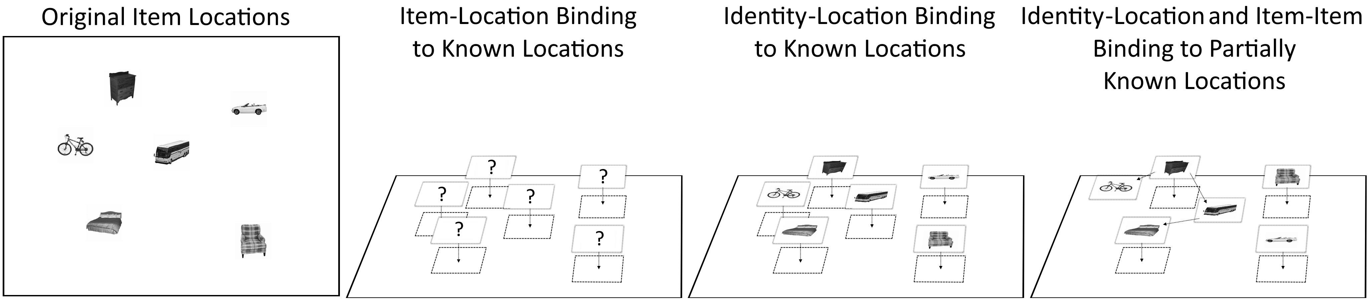
Models of Information in Reconstruction
Introduction
Reconstructing Relational Information
Spatiotemporal Reconstruction
Spatiotemporal Navigation
Conclusion
After reconstruction, some level of inference is required to determine what information was/wasn’t present in the reconstructed locations
The framework involves three key types of information
Identity-location binding
Location-location (or Item-item) relations
Location-environment (or Item-environment) relations
Misplacement error can be broken down into these different types of information

Slide 10




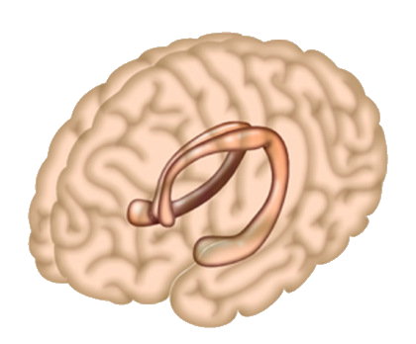






Bringing it All Together
Introduction
Reconstructing Relational Information
Spatiotemporal Reconstruction
Spatiotemporal Navigation
Conclusion
Context
Episodes
Space
Time
Sampling

Slide 11
Reconstructing Relational Information
Introduction
Reconstructing Relational Information
Spatiotemporal Reconstruction
Spatiotemporal Navigation
Conclusion
Study 1 (In Press)
Episodes
Space

Slide 12
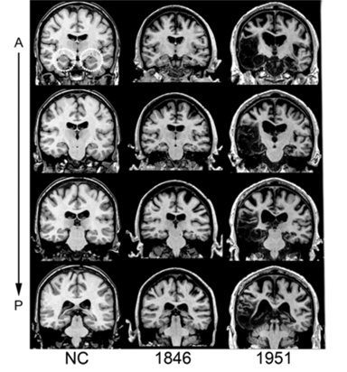
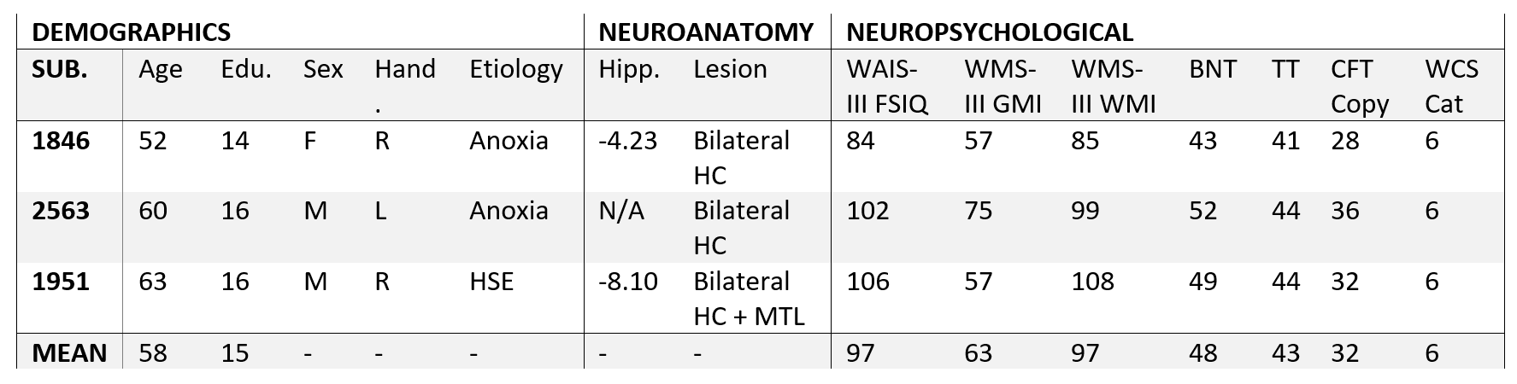
Patient Demographics
Introduction
Reconstructing Relational Information
Spatiotemporal Reconstruction
Spatiotemporal Navigation
Conclusion
3 patients with bilateral HC damage (one, 1951, with additional MTL damage)
9 age and education matched controls
Patients had normal performance on measures of intelligence, language, visual perception, and executive function

Slide 13





Spatial Reconstruction The iPosition Task
Introduction
Reconstructing Relational Information
Spatiotemporal Reconstruction
Spatiotemporal Navigation
Conclusion

Slide 14
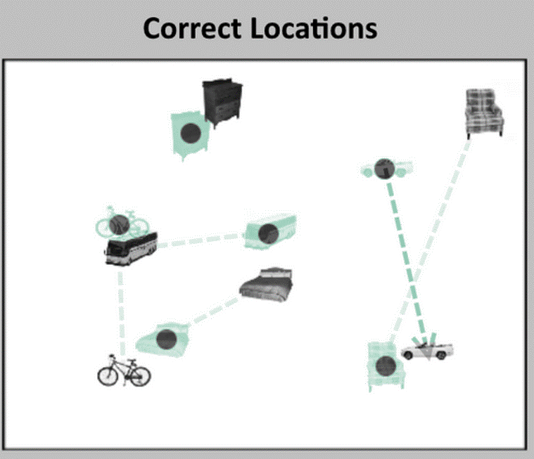
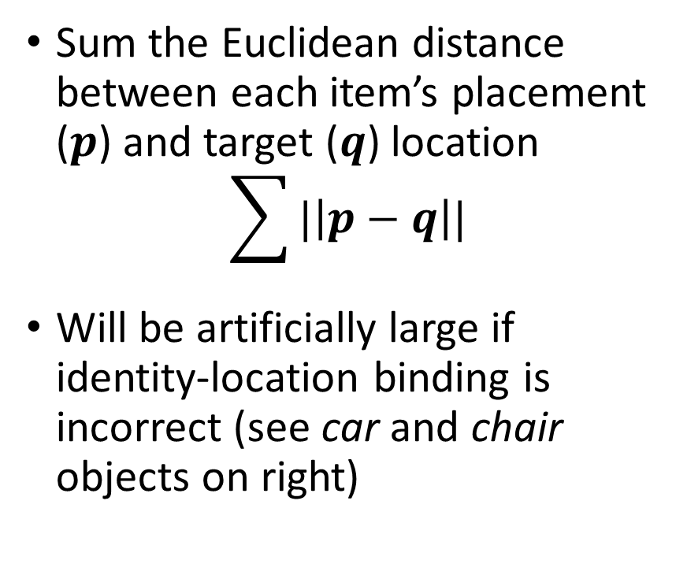
Traditional Analysis Misplacement
Introduction
Reconstructing Relational Information
Spatiotemporal Reconstruction
Spatiotemporal Navigation
Conclusion
Sum the Euclidean distance between each item’s placement ($p$) and target ($q$) location
$$\sum{|\left|p−q\right||}$$
Will be artificially large if identity-location binding is incorrect (see car and chair objects on right)
Note: Green/dots are correct locations

Slide 15
Reconstruction Relations Relation Types
Introduction
Reconstructing Relational Information
Spatiotemporal Reconstruction
Spatiotemporal Navigation
Conclusion
A – Item-item and item-environment relational information
B – Identity-location relational information
C – Compound relational information

Slide 16
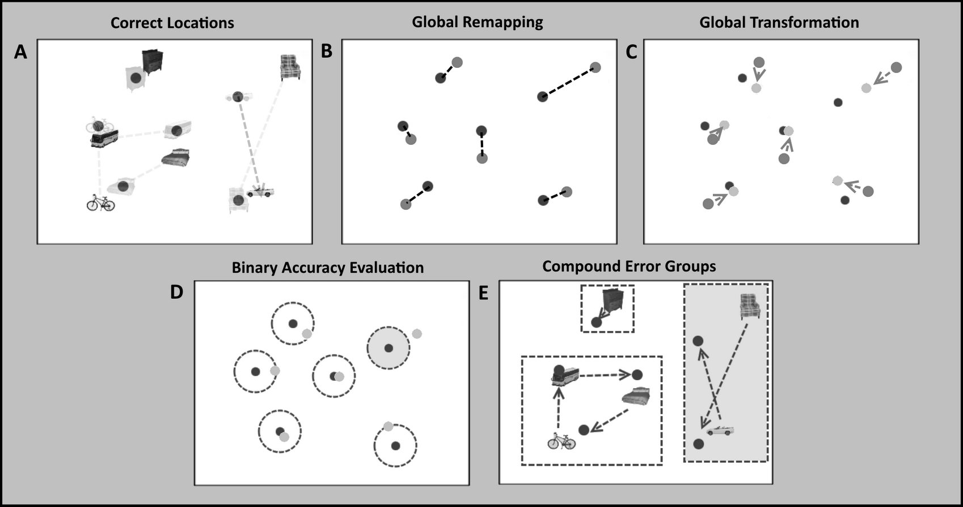
Reconstruction Errors Better Than Just Misplacement
Introduction
Reconstructing Relational Information
Spatiotemporal Reconstruction
Spatiotemporal Navigation
Conclusion
Errors are used to infer successful or unsuccessful memory for relations
To evaluate errors we:
Remove the identities of items and find a minimal association (i.e. a remapping of item-to-location which “forgives” errors due to identity misbinding)
Find shared error across items (i.e. “forgive” translation, scaling, and rotation errors)
Evaluate placement accuracy in any location (i.e. if an item is close enough to any item’s target location)
Determine if any errors exist within a compound error group

Slide 17
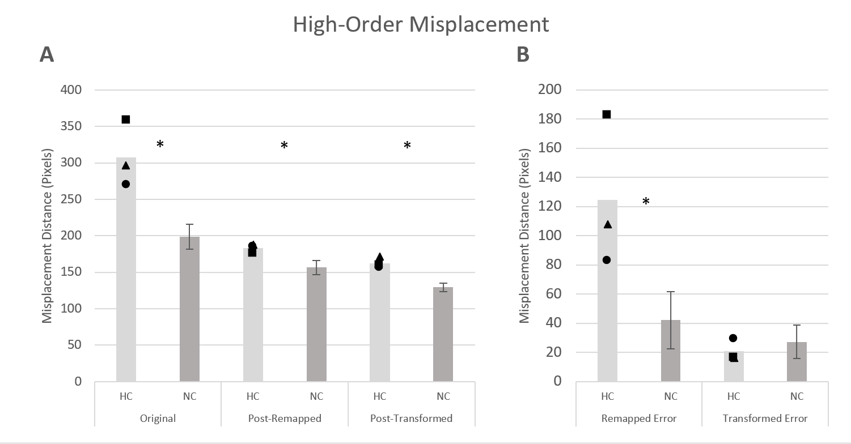
Hippocampal Damaged Patients Misplacement After Error Correction
Introduction
Reconstructing Relational Information
Spatiotemporal Reconstruction
Spatiotemporal Navigation
Conclusion
Patients have higher overall misplacement to begin with
Most of the misplacement (i.e. Euclidean distance of reconstructed points to targets) difference between patients and controls is due to identity-location binding
Total transformation error (translation, scaling, and rotation) does not differ between groups
These errors do not account for all group differences (i.e. some “local” error persists)
Subtraction of Left gives us the Right

Slide 18
Identity-Location Relational Errors
Introduction
Reconstructing Relational Information
Spatiotemporal Reconstruction
Spatiotemporal Navigation
Conclusion

Slide 19
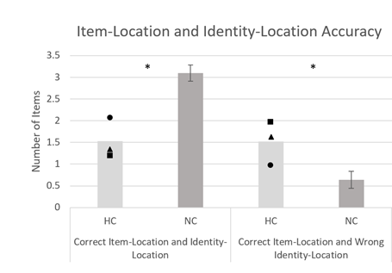
Hippocampal Damaged Patients (cont.) Misplacement After Error Correction
Introduction
Reconstructing Relational Information
Spatiotemporal Reconstruction
Spatiotemporal Navigation
Conclusion
Patients get fewer items correct overall
Identity-location errors (i.e. the number of items placed in another item’s location) occur more often in patients
No difference is found in memory for locations (i.e. the sum of the two bar graphs)
Note: Number of Items is the Average Number of Items Per Trial which fit the various criteria

Slide 20
Compound Identity-location Relational Errors Swaps and Cycles
Introduction
Reconstructing Relational Information
Spatiotemporal Reconstruction
Spatiotemporal Navigation
Conclusion

Slide 21
Compound Relational Errors Cycles and Swaps
Introduction
Reconstructing Relational Information
Spatiotemporal Reconstruction
Spatiotemporal Navigation
Conclusion
No significant differences is present between cycles and swaps if all items in the group are required to have accurate location information
For “partial” cycles and swaps, there are differences, but no strong inference about compound errors can be made from this
Notes:
This comparison is from my data set.

Slide 22
Take-Aways
Introduction
Reconstructing Relational Information
Spatiotemporal Reconstruction
Spatiotemporal Navigation
Conclusion
The hippocampus is critical binding of arbitrary information (identity-location binding)
Some relational information can be reconstructed by hippocampal damaged patients (location information without identities – though precision may be impaired)
Compound errors are not more common with hippocampal damage
Healthy individuals also commit relational errors once the task becomes sufficiently demanding

Slide 23
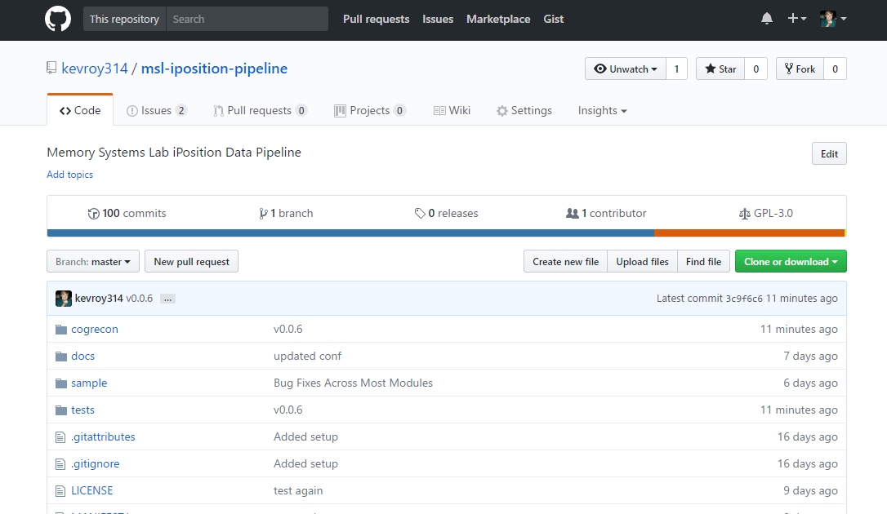
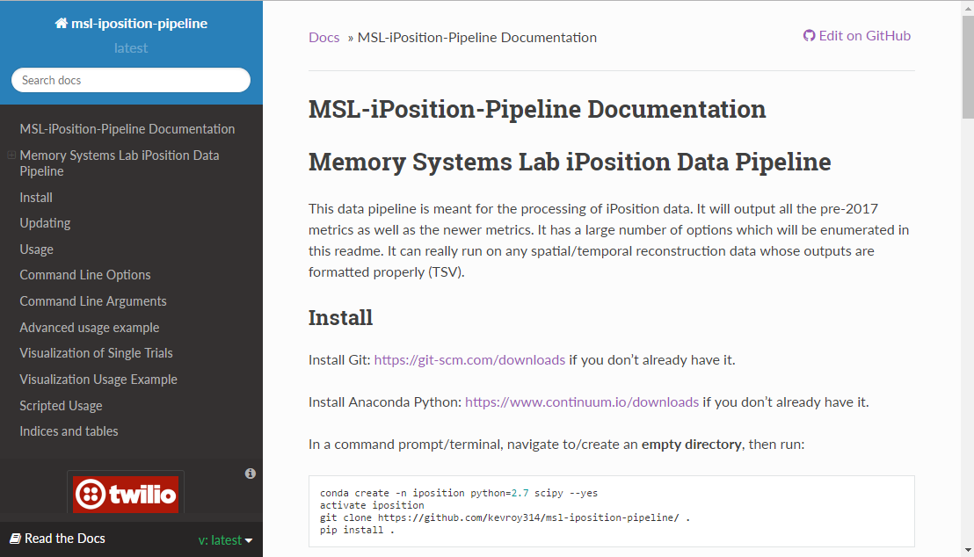
MSL iPosition Pipeline
Introduction
Reconstructing Relational Information
Spatiotemporal Reconstruction
Spatiotemporal Navigation
Conclusion
The analysis code is all open source on GitHub.

Slide 24
Memory During Time Travel
Introduction
Reconstructing Relational Information
Spatiotemporal Reconstruction
Spatiotemporal Navigation
Conclusion
Spatiotemporal Navigation, Contextual Boundaries, and Relational Memory Errors in Virtual Reality
Study 2 (Manuscript Prepared)
Context
Episodes
Space
Time

Slide 25
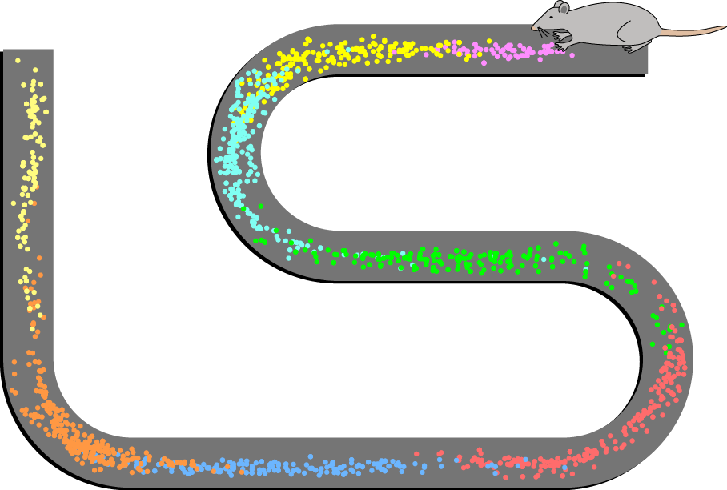
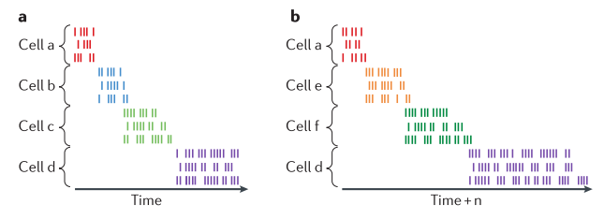
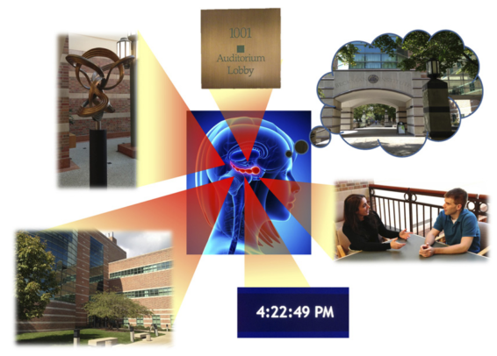
Episodic Memory
Introduction
Reconstructing Relational Information
Spatiotemporal Reconstruction
Spatiotemporal Navigation
Conclusion
Place cells fire in association with specific, allocentrically defined locations in space during navigation
Place cells can remap in accordance with translation and scaling transformations but not changes in shape
“Time” cells fire in relation to moments in time relative to the start of a trial
Time cells scale with scaling of temporal distances (see a vs. b on the bottom right)
Episodic memory can be defined as memory for specific/precise events in space and time, framed by context
Context can be defined as additional, often more stable/protracted, information which is indirectly related to an episode
Episodic memory critically relies on the hippocampus

Slide 26
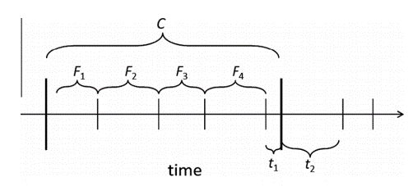
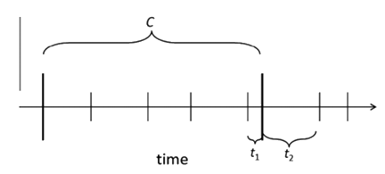
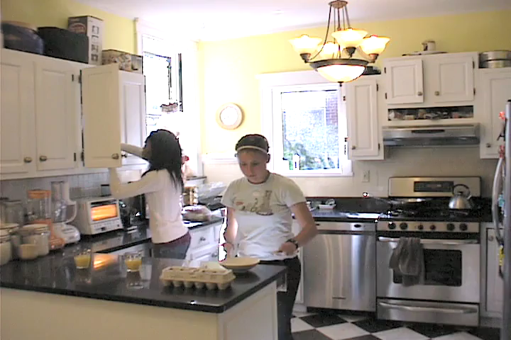
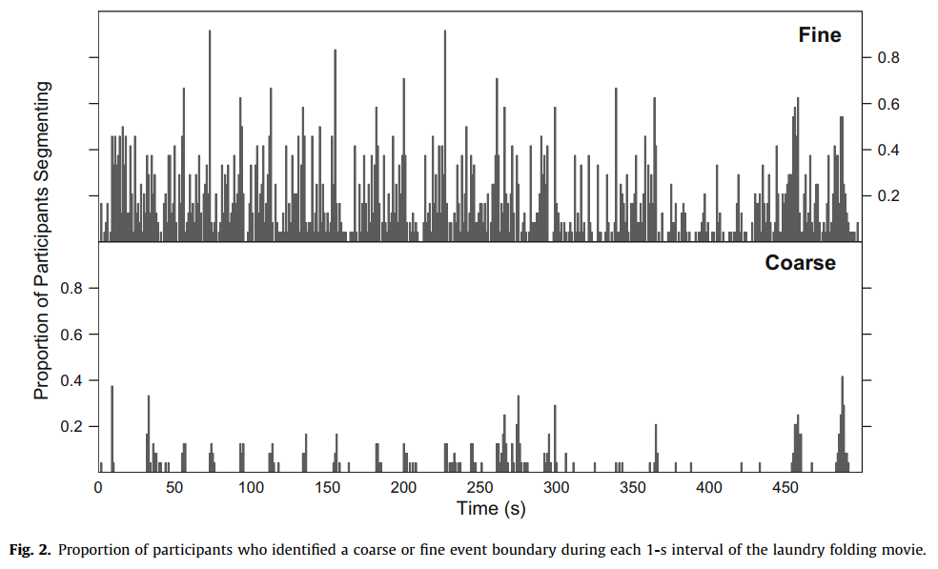
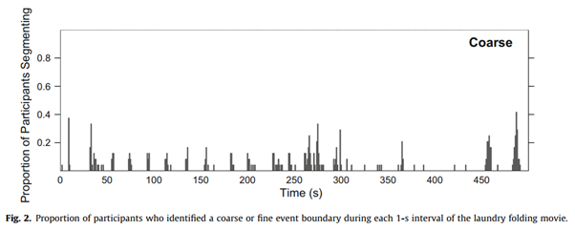
Zacks et al. 2007
Introduction
Reconstructing Relational Information
Spatiotemporal Reconstruction
Spatiotemporal Navigation
Conclusion
Event modeling: what constitutes an “event” and how events are segmented?
Zacks et al. has shown that individuals naturally segment continuous streams of information into event segments of different resolutions
Coarsely, event boundaries divide up continuous time to aid in describing and organizing memory for those events

Slide 27
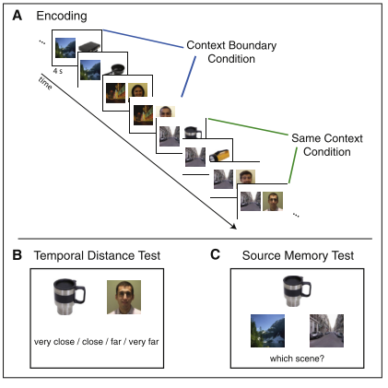
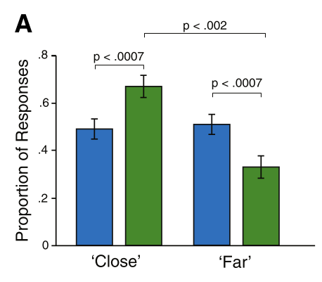
Davachi et al. 2013
Introduction
Reconstructing Relational Information
Spatiotemporal Reconstruction
Spatiotemporal Navigation
Conclusion
Discrete distance judgements and source memory were evaluated
For “Close” and “Far” judgements, a context boundary effect can be seen such that objects separated by a boundary are more likely to be judged as “Far”
This effect has also been related to the hippocampus

Slide 28
Tulving’s Time Travel
Introduction
Reconstructing Relational Information
Spatiotemporal Reconstruction
Spatiotemporal Navigation
Conclusion
“Time’s arrow is straight… the singular exception is provided by the human ability to remember past happenings… The rememberer has mentally traveled back into her past…” – Tulving, 2002

Slide 29
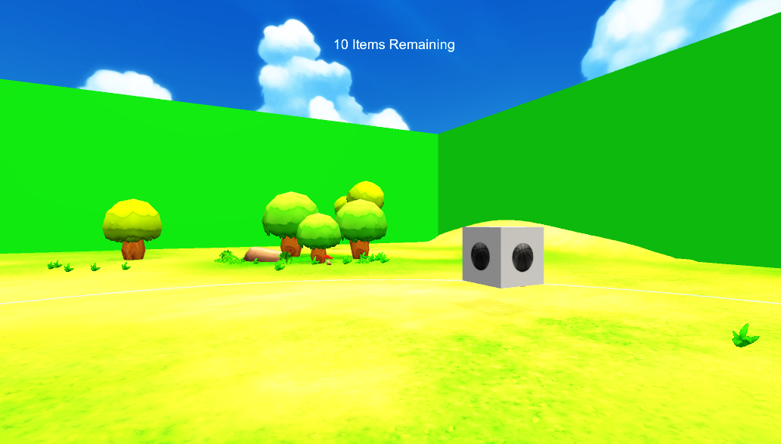
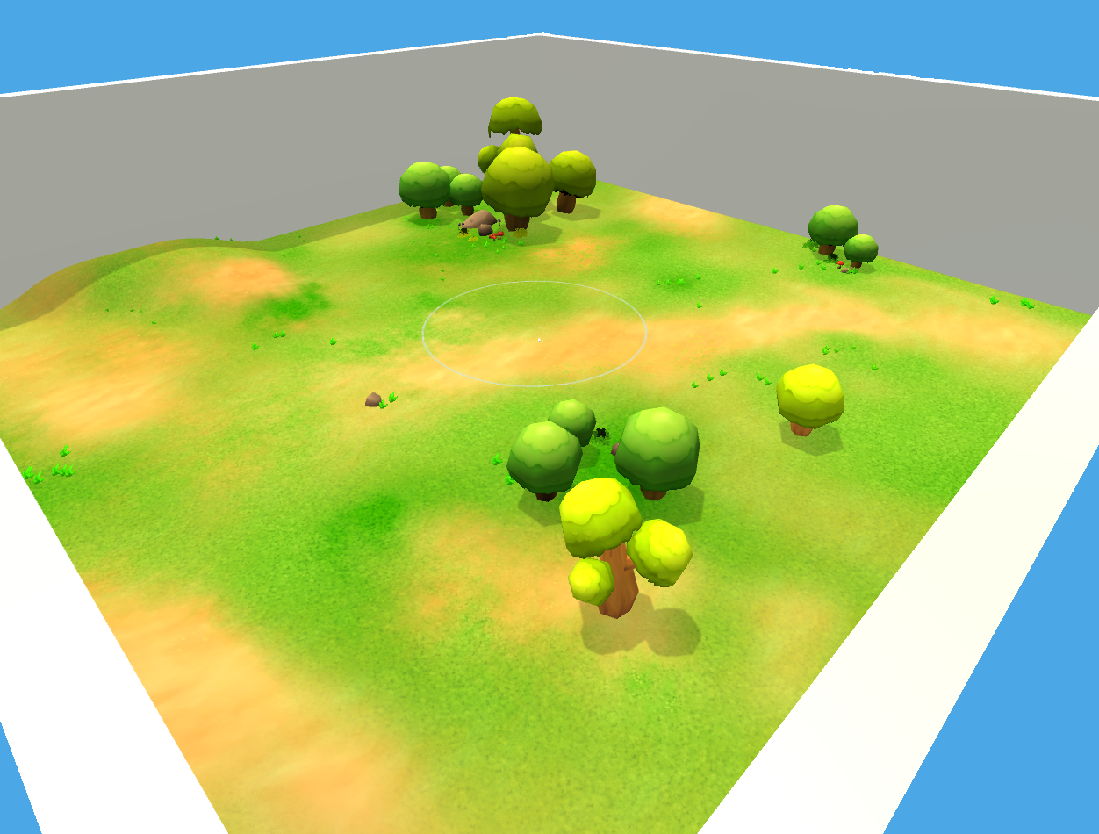
Spatiotemporal Reconstruction in VR
Introduction
Reconstructing Relational Information
Spatiotemporal Reconstruction
Spatiotemporal Navigation
Conclusion

Slide 30
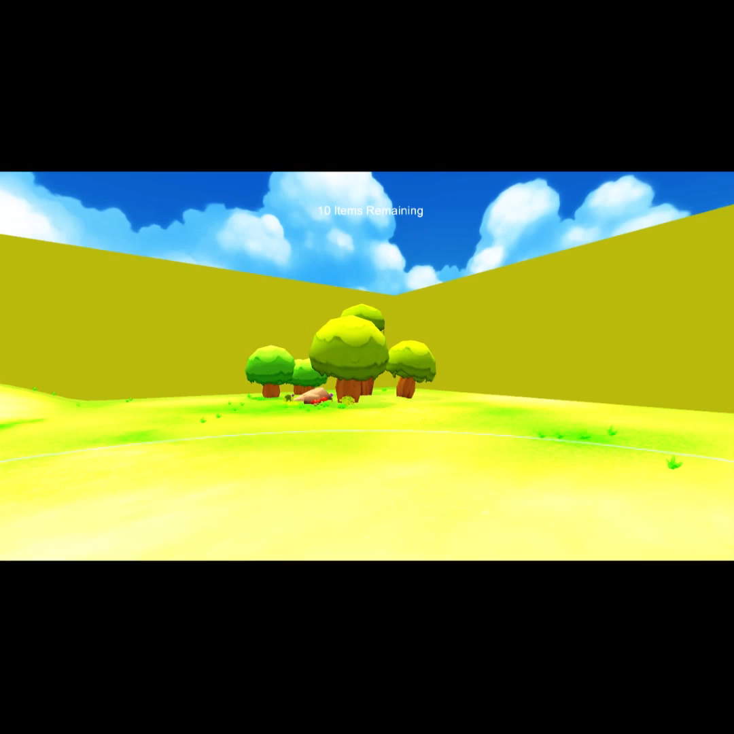
Spatiotemporal Reconstruction in VR (cont.)
Introduction
Reconstructing Relational Information
Spatiotemporal Reconstruction
Spatiotemporal Navigation
Conclusion
43 young adult participants (ages 18-24; 23 male)
Virtual Reality using the Oculus Rift
Study events in space and time
4 study/test trials with the same set of events in the same environment

Slide 31
Overall Performance
Introduction
Reconstructing Relational Information
Spatiotemporal Reconstruction
Spatiotemporal Navigation
Conclusion
Overall performance improved across trials on simple study and test metrics (errors space and time)
Error in space seemed to hit floor by trial 3 while time continued to improve

Slide 32
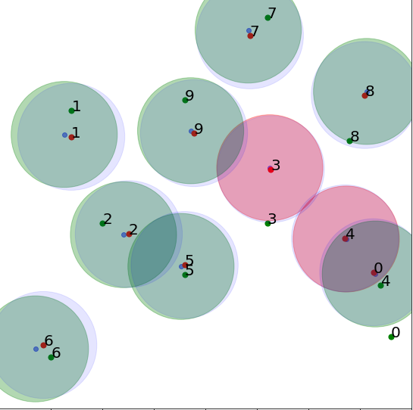
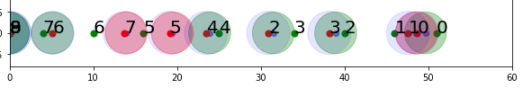
Identity-location Errors in Space vs. Time
Introduction
Reconstructing Relational Information
Spatiotemporal Reconstruction
Spatiotemporal Navigation
Conclusion
Analyze space and time independently
Use relational memory metrics (identity-location errors)
There are far more relational memory errors in space than in time in this task
Space (m)
Time (s)
Note: Number of Identities is the Average Number of Identities Per Trial which fit the various criteria

Slide 33
Context and Relational Memory
Introduction
Reconstructing Relational Information
Spatiotemporal Reconstruction
Spatiotemporal Navigation
Conclusion
Identity-location errors (temporal item misbindings) would be expected by chance to occur within context around 14% of the time
They occur >40% of the time, and the error gets worse across trials
This is true even when looking at the raw Identity-location errors

Slide 34
Temporal Context Boundary Effects
Introduction
Reconstructing Relational Information
Spatiotemporal Reconstruction
Spatiotemporal Navigation
Conclusion
Context Boundary Effects are scaling transformations
They reflect a systematic bias due to context on distance judgements
This bias is not diminished by restudy or freely crossing boundaries

Slide 35
Take-Aways
Introduction
Reconstructing Relational Information
Spatiotemporal Reconstruction
Spatiotemporal Navigation
Conclusion
Relational memory errors are far more common in temporal location information than spatial in this task
Context boundaries influence relational memory/order memory performance such that within context relational errors occur more often with restudy
Context boundary effects are persistent even with restudy and the ability to freely cross context boundaries

Slide 36
Spatiotemporal Navigation, Sampling, and Information In-The-Moment in Virtual Reality
Spatiotemporal Reconstruction
Introduction
Spatiotemporal Reconstruction
Introduction
Reconstructing Relational Information
Reconstructing Relational Information
Spatiotemporal Navigation
Spatiotemporal Navigation
Conclusion
Conclusion
Path and Order Analyses
Study 3 (Proposed)
Context
Episodes
Space
Time
Sampling

Slide 37
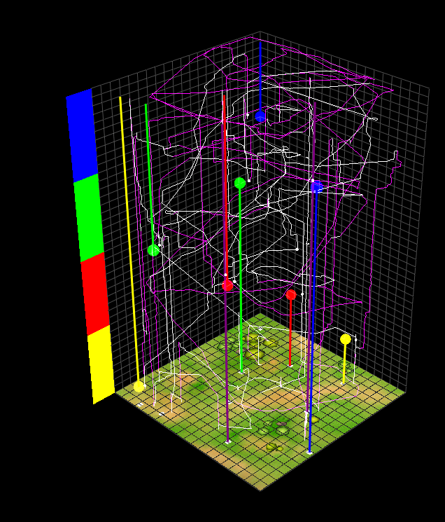
Spatial Distance and Temporal Distance
Introduction
Reconstructing Relational Information
Spatiotemporal Reconstruction
Spatiotemporal Navigation
Conclusion
Space and time can be explored independently, so spatial and temporal distance travelled can be measured in isolation of one another
Both distance metrics use Euclidean, L2 distance
Note: Spatial distance can be travelled without moving in time & temporal distance can be travelled without moving in space
Temporal Distance
Spatial Distance

Slide 38
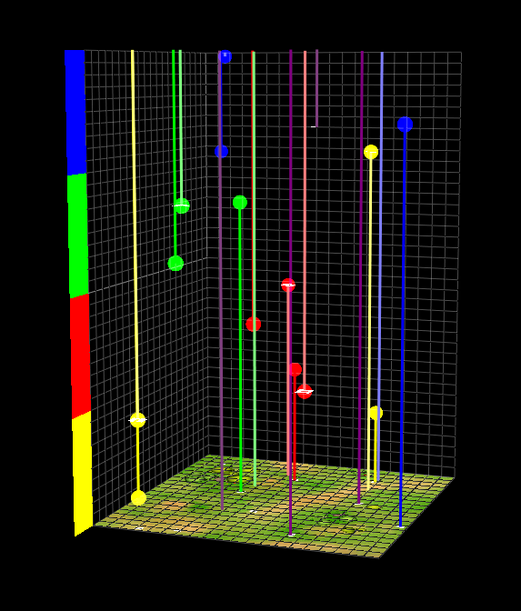
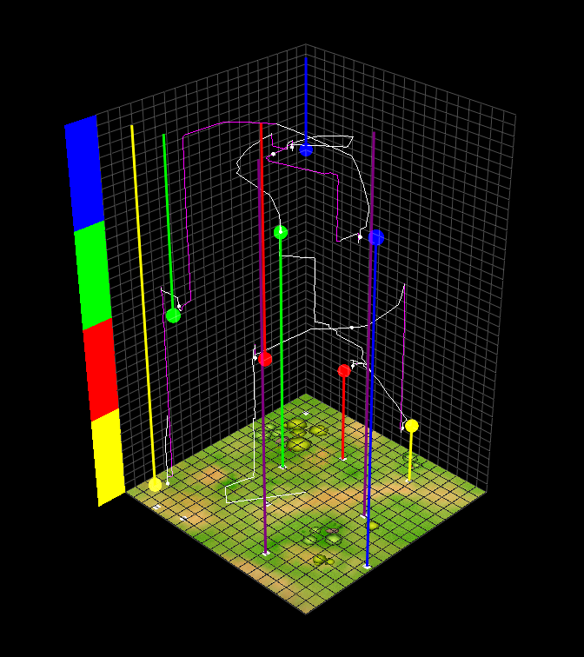
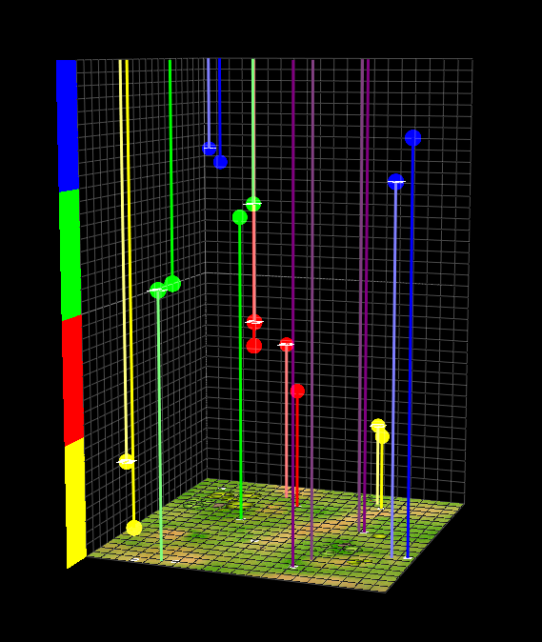
Study Exploration vs. Test Metrics
Introduction
Reconstructing Relational Information
Spatiotemporal Reconstruction
Spatiotemporal Navigation
Conclusion
Study
Test
Trial 1
These metrics improve across trials
The relationship between these metrics and test time results will also be explored
Trial 4

Slide 39
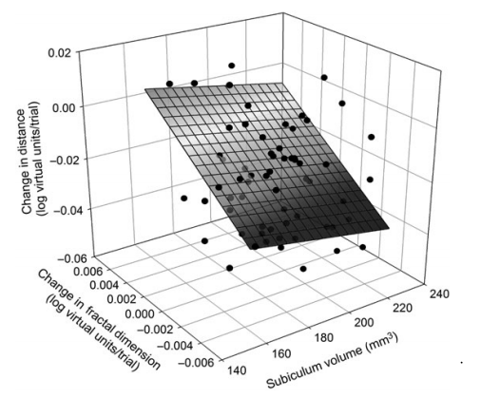
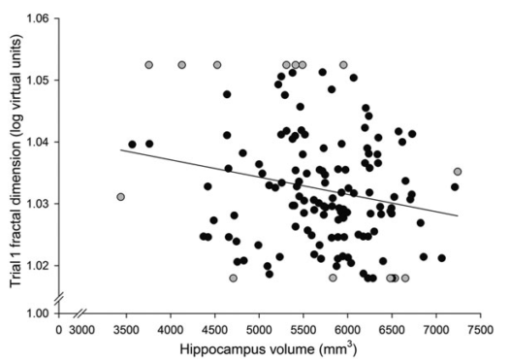
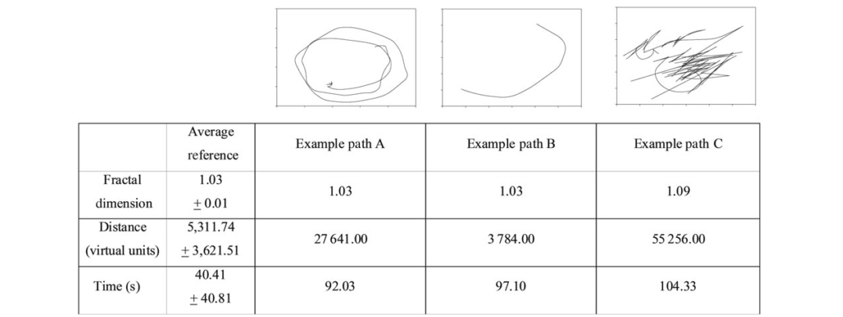
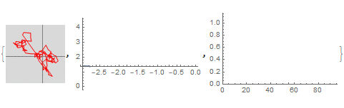

Fractal Dimension (FD)
Introduction
Reconstructing Relational Information
Spatiotemporal Reconstruction
Spatiotemporal Navigation
Conclusion
Used previously in Virtual Morris Water Maze
FD is a measure of the complexity of a path, rather than its explicit distance in space
Changes in FD across spatial navigation trials have been associated with hippocampal volume
Changes in FD as well as distance learning slope have been related to subiculum volume
Example Path
Linear Fit
Slope of Fit (aka FD)

Slide 40
Planned Path Analyses
Introduction
Reconstructing Relational Information
Spatiotemporal Reconstruction
Spatiotemporal Navigation
Conclusion
Measure | Comparison | Support | Hypotheses
Spatial Distance | All Test Measures | (Maguire et al., 1999; Moffat, 2009; Moffat & Resnick, 2002) | None (exploratory)
Temporal Distance | All Test Measures | (Kraus et al., 2015a) | None (exploratory)
Fractal Dimension | Relational Memory Error | (Daugherty et al., 2015) | Higher FD will relate to poorer relational memory performance.
Context Boundary Crossings | Context Boundary Effect & Context-Relational Errors | (Ezzyat & Davachi, 2014; Zacks et al., 2007) | More context crossings will relate to greater context boundary effects and more context-relational errors.
Item Sampling | Item Misplacement | (Hannula et al., 2010) | In early trials, more sampling will relate to better memory. In later trials, less sampling will relate to better memory.

Slide 41
Order Information Metrics
Introduction
Reconstructing Relational Information
Spatiotemporal Reconstruction
Spatiotemporal Navigation
Conclusion
How should we treat order?
Order of study (i.e. clicking to acknowledge the events)
Order of test (i.e. placing the items in given locations)
Ideally, we want a hypothesized order and a test of how “close” participants are to that order; aka a distance metric for order
An illustration:
Which is closer to [1,2,3,4,5,6,7,8]:
[8,7,6,5,4,3,2,1],
[5,6,7,8,1,2,3,4], or
[2,1,4,3,6,5,8,7]?
Reflection
Rearrangement
Item-Wise

Slide 42
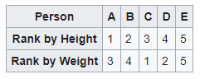


Kendall Tau Distance Item-Wise and Reflection
Introduction
Reconstructing Relational Information
Spatiotemporal Reconstruction
Spatiotemporal Navigation
Conclusion
Represents pairwise rearrangements (including reflections)
Positive 1.0 is forward ordering (i.e. 1,2,3,4,5,…)
Negative 1.0 is reverse ordering (i.e. 8,7,6,5,4,…)
0.0 is maximally far from either of those options
Note that across all possible permutations, 0.0 is the most common result and 1.0 or -1.0 are extremely improbable by chance
This method penalizes contiguity (i.e. 5,6,7,8,1,2,3,4)

Slide 43


Contiguity Distance Rearrangement
Introduction
Reconstructing Relational Information
Spatiotemporal Reconstruction
Spatiotemporal Navigation
Conclusion
Count the number of contiguous sublists
Example: [5,6,7,8,1,2,3,4] has two contiguous sublists [5,6,7,8] and [1,2,3,4]
Note that if the reverse direction were hypothesized, this could easily be performed in reverse (i.e. [4,3,2,1,8,7,6,5] has two contiguous sublists [4,3,2,1] and [8,7,6,5])
Together, Kendall Tau and Contiguous Distance make a 2D distance space

Slide 44


Trial-Over-Trial Flow
Introduction
Reconstructing Relational Information
Spatiotemporal Reconstruction
Spatiotemporal Navigation
Conclusion
We can visualize the space in 3D where vertical is the probability of each discrete distance combination
The point at (1.0, 0.0) corresponds to a hypothetical convergence towards “forward” exploration and reconstruction
We can construct a hypothetical probability distribution and observe what a trend like this should look like

Slide 45
Planned Path Analyses
Introduction
Reconstructing Relational Information
Spatiotemporal Reconstruction
Spatiotemporal Navigation
Conclusion
Measure | Comparison | Support | Hypotheses
Spatial Distance | All Test Measures | (Maguire et al., 1999; Moffat, 2009; Moffat & Resnick, 2002) | None (exploratory)
Temporal Distance | All Test Measures | (Kraus et al., 2015a) | None (exploratory)
Fractal Dimension | Relational Memory Error | (Daugherty et al., 2015) | Higher FD will relate to poorer relational memory performance.
Context Boundary Crossings | Context Boundary Effect & Context-Relational Errors | (Ezzyat & Davachi, 2014; Zacks et al., 2007) | More context crossings will relate to greater context boundary effects and more context-relational errors.
Item Sampling | Item Misplacement | (Hannula et al., 2010) | In early trials, more sampling will relate to better memory. In later trials, less sampling will relate to better memory.
Order Analyses | Order Over Trials Study vs. Test Order | Novel Metric | Order will converge to “allocentric,” map-like order (i.e. 1,2,3,4,5,6,7,8). Study and Test Order will be similar.

Slide 46
Overall Conclusions
Introduction
Reconstructing Relational Information
Spatiotemporal Reconstruction
Spatiotemporal Navigation
Conclusion
Not all types of relations are impaired in hippocampal damage, but specifically arbitrary relations are impaired
Space and time may be represented separably in the hippocampus
Contextual shifts systematically bias both relational memory and distance judgements in time
Spatiotemporal navigation tasks can be used to study cognitive maps in the temporal domain in the service of in-the-moment, memory guided behavior
Context
Episodes
Space
Time
Sampling

